Slide 1
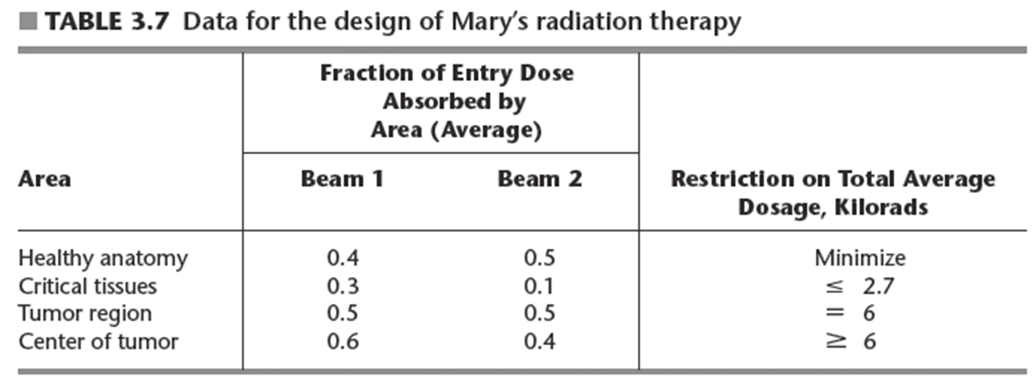
Design of radiation therapy for Mary’s cancer treatment
Goal: select best combination of beams and their intensities to generate best possible dose distribution
Notes:
Dose is measured in kilorads

Slide 2

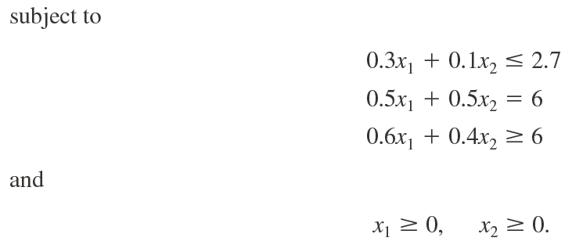
Example: Radiation Therapy Design
Linear programming model
Using data from Table 3.7

